Slide 1
Technology and Innovation Through AI
How Artificial Intelligence is Shaping the Future
Name: Al-Amin
Date: 21-01-25

Slide 2
Introduction to AI
Definition of AI: Artificial Intelligence refers to machines designed to think, learn, and adapt like humans.
Types of AI: Narrow AI (specialized tasks) vs General AI (human-like cognition)
Importance of AI: Revolutionizing industries by automating processes, improving efficiency, and unlocking new possibilities.

Slide 3
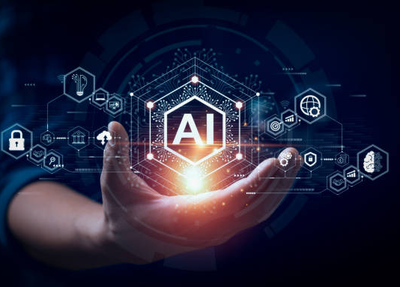
The Role of AI in Technological Advancements
Automation: AI powers robotics and manufacturing automation.
Data Analysis: Big data processing and predictive analytics.
Personalization: AI in consumer services (recommendations, personalization).

Slide 4
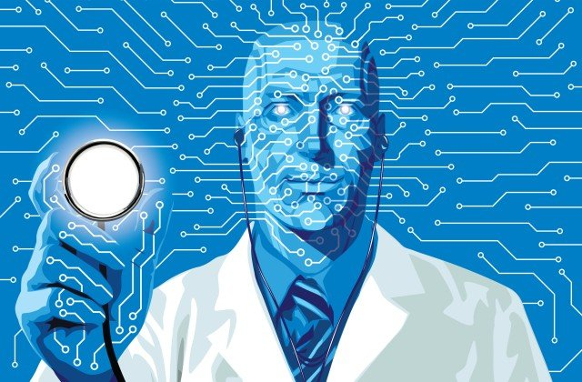
AI in Healthcare Innovation
Medical Imaging: AI assists in diagnosing diseases with high accuracy.
Drug Discovery: AI accelerates the development of new drugs.
Virtual Health Assistants: AI-based chatbots and diagnostic tools improving access to healthcare.

Slide 5
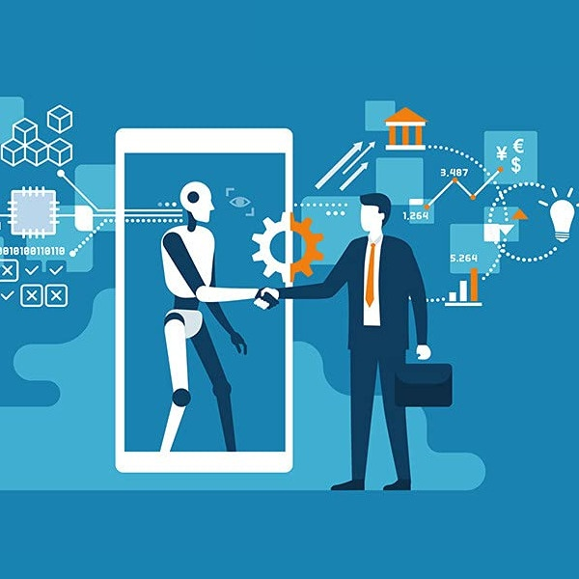
AI in Business and Industry
Smart Manufacturing: AI-driven predictive maintenance and optimization of production.
Customer Service: Chatbots and AI tools providing better customer support.
Supply Chain Optimization: AI improving logistics, inventory management, and forecasting.
ThePhoto by PhotoAuthor is licensed under CCYYSA.

Slide 6
AI in Education
Personalized Learning
Grading and Assessment
Virtual Classrooms

Slide 7
AI in Sustainability and Environment
Energy Efficiency: AI optimizing energy usage and reducing waste.
Climate Change: AI models predicting climate trends and helping in environmental conservation.
Smart Cities: AI enhancing urban living through smarter resource management.

Slide 8
Ethical Considerations in AI
Bias and Fairness: AI models can inherit biases from training data.
Privacy: How AI impacts data privacy and security.
Job Displacement: The need for upskilling workers as automation increases.

Slide 9
Future of AI Innovations
AI and Creativity: AI can now create original artworks and music, pushing the boundaries of traditional creativity.
Enhancing Human Abilities: Advancements in brain-computer interfaces and AI prosthetics improve capabilities and quality of life for those with disabilities.
Challenges Ahead: Addressing ethical, regulatory, and social implications is vital for ensuring AI benefits society without worsening inequalities.

Slide 10
some disadvantages of artificial intelligence (AI)
1. Job Displacement
2. High Initial Costs
3. Lack of Creativity and Emotional Intelligence
4. Dependence on Technology
5. Ethical Concerns
6. Security Risks
7. Loss of Human Touch
8. Limited Understanding
9. Environmental Impact
10. Potential for Misuse

Slide 11
Conclusion
Summary: AI is transforming numerous sectors, driving innovation, and addressing complex challenges.
Key Takeaways:
AI is a tool for progress in industries like healthcare, business, and sustainability.
Ongoing ethical considerations are crucial for responsible innovation.
Call to Action: Embrace AI for a smarter and more efficient future, but approach its challenges thoughtfully.

Slide 12
THANKS

